Slide 1

ITP 259: Basics of Artificial Intelligence Fall 2024 Lecture 6: Review of supervised machine learning
Dr. Martin Prescher
(other sections & a lot of the material: Prof. Nitin kalÉ) Information technology Program
Viterbi school of engineering

Slide 2
“What will happen to me if I fail your test?”
- AVA, Ex Machina, 2014

Slide 3
Outline
Machine Learning
Unsupervised
Clustering
Association Analysis
Supervised
Approximation / Estimation
Linear Regression
Logistic Regression
Neural Networks
Classification
kNN
SVM
Decision Trees
Näive Bayes
Neural Networks

Slide 4
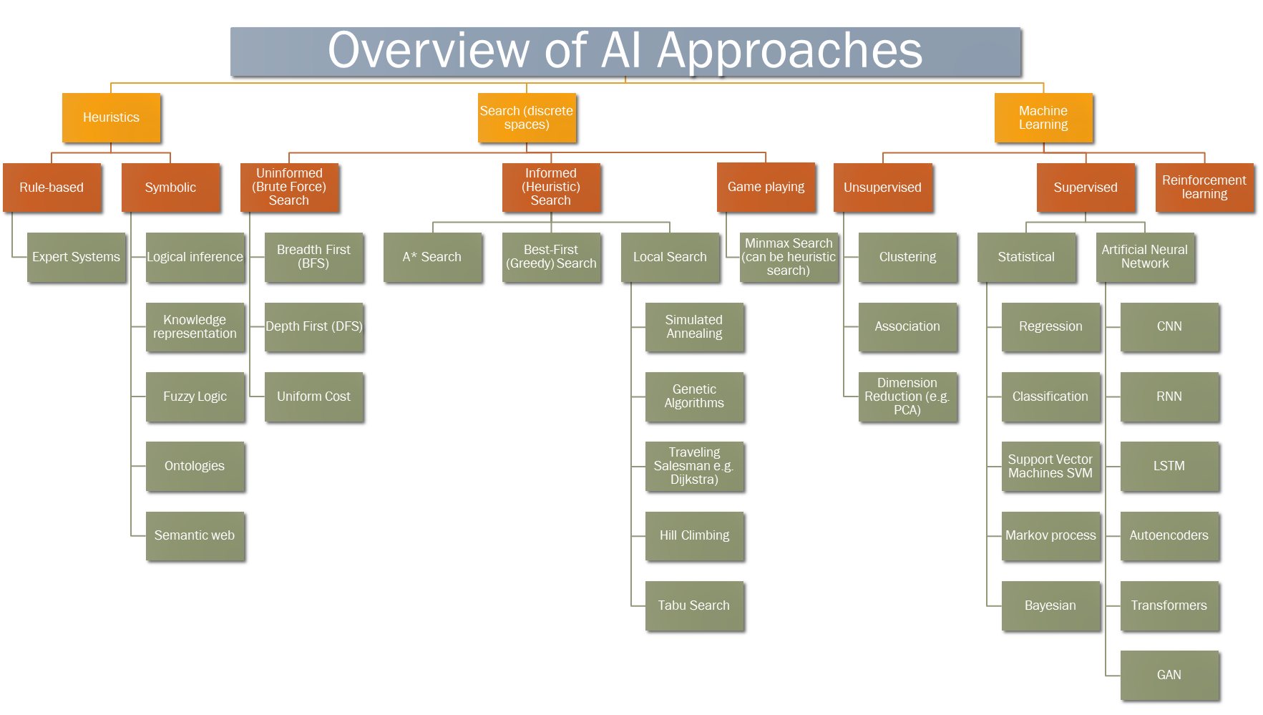
Supervised Learning
K-means
KNN (k-nearest-neighbor)
Problem Statement:
Given a Target variable: Predict the value or category of a target (response) variable based on a group of predictor variables (features, factors)

Slide 5
Supervised Learning
Target variable: Predict the value or category of a target (response) variable based on a group of predictor variables (features, factors)
Approximation / Estimation
Regression Used to predict continuous numeric outcomes
Logistic regression Classification algorithm
Neural Networks: A network of artificial neurons that can be trained for regression (and classification)
Classification
k-Nearest Neighbors (kNN) Classification algorithm that classifies data into two or more categories
Support Vector Machines (SVM) Classification algorithm that is used in image and face detection
Tree-Based algorithms Tree-based algorithms such as decision trees and Random Forests are used to solve both classification and regression problems
Näive Bayes Uses the mathematical model of probability to solve classification problems
Neural Networks

Slide 6
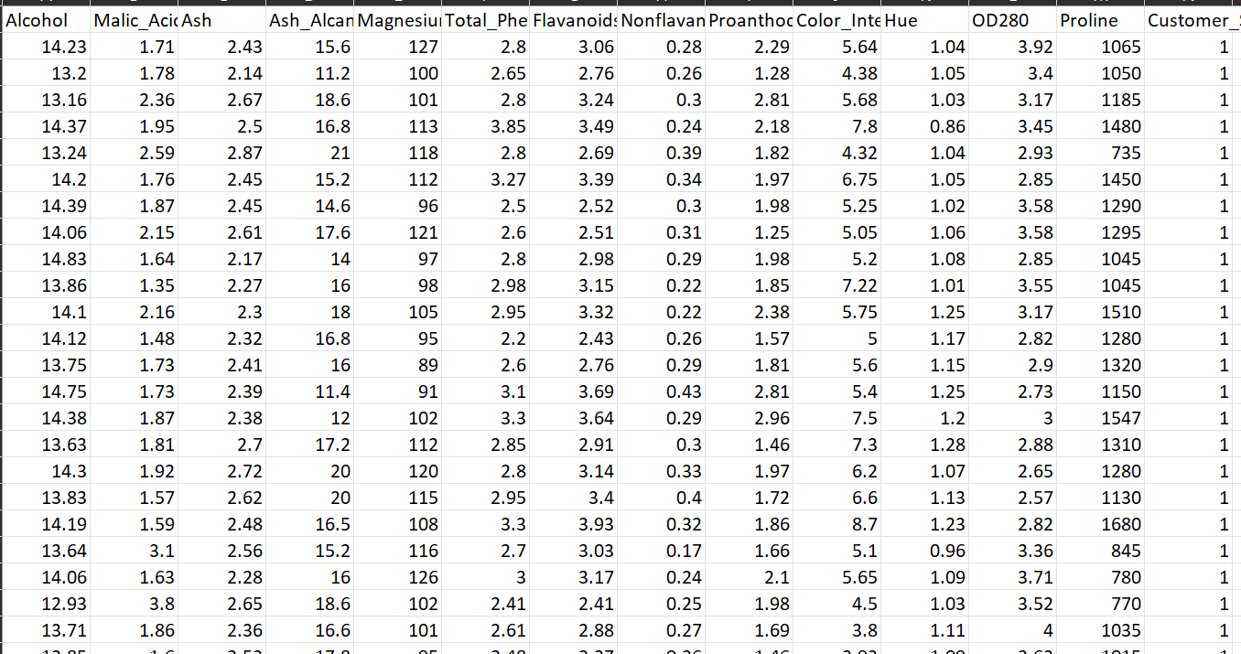
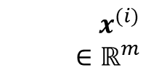
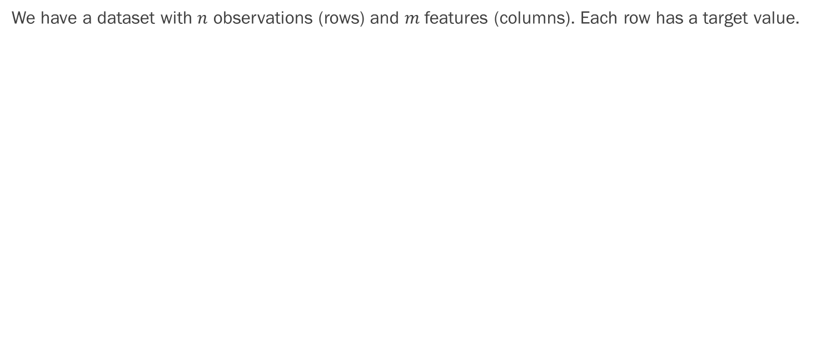
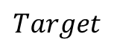
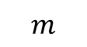
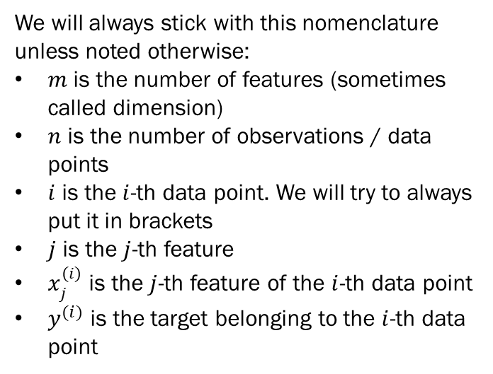
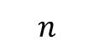
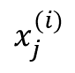
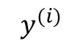
Quick Nomenclature (slide will return)
We have a dataset with $n$ observations (rows) and $m$ features (columns). Each row has a target value.
$$m$$
$$Target$$
We will always stick with this nomenclature unless noted otherwise:
$m$ is the number of features (sometimes called dimension)
$n$ is the number of observations / data points
$i$ is the $i$-th data point. We will try to always put it in brackets
$j$ is the $j$-th feature
$x_{j}^{(i)}$ is the $j$-th feature of the $i$-th data point
$y^{(i)}$ is the target belonging to the $i$-th data point
$$x^{(i)} \\ ∈ℝ^{m}$$
$$y^{(i)}$$
$$n$$
$$x_{j}^{(i)}$$

Slide 7
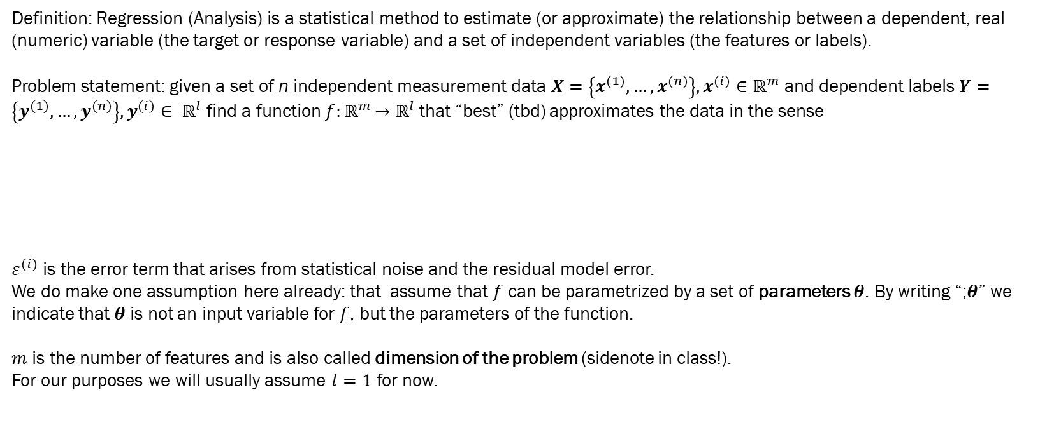
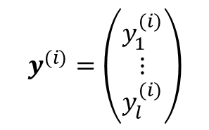
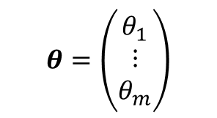
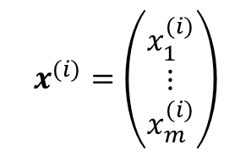
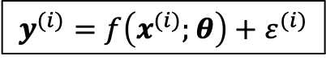
Regression
Definition: Regression (Analysis) is a statistical method to estimate (or approximate) the relationship between a dependent, real (numeric) variable (the target or response variable) and a set of independent variables (the features or labels).
Problem statement: given a set of n independent measurement data $X=\left\{x^{(1)},…,x^{(n)}\right\},x^{(i)}∈$ $ℝ^{m}$ and dependent labels$Y=\left\{y^{(1)},…,y^{(n)}\right\},y^{(i)}∈ ℝ^{l}$ find a function $f{:ℝ}^{m}→ℝ^{l}$ that “best” (tbd) approximates the data in the sense
$ε^{(i)}$ is the error term that arises from statistical noise and the residual model error.
We do make one assumption here already: that assume that $f$ can be parametrized by a set of parameters $θ$. By writing “;$θ$” we indicate that $θ$ is not an input variable for $f$, but the parameters of the function.
$m$ is the number of features and is also called dimension of the problem (sidenote in class!).
For our purposes we will usually assume $l=1$ for now.
$$x^{(i)}=\left(\begin{aligned}x_{1}^{(i)} \\ ⋮ \\ x_{m}^{(i)}\end{aligned}\right)$$
$$θ=\left(\begin{aligned}θ_{1} \\ ⋮ \\ θ_{m}\end{aligned}\right)$$
$$y^{(i)}=\left(\begin{aligned}y_{1}^{(i)} \\ ⋮ \\ y_{l}^{(i)}\end{aligned}\right)$$
$$y^{(i)}=f\left(x^{(i)};θ\right)+ε^{(i)}$$
?

Slide 8
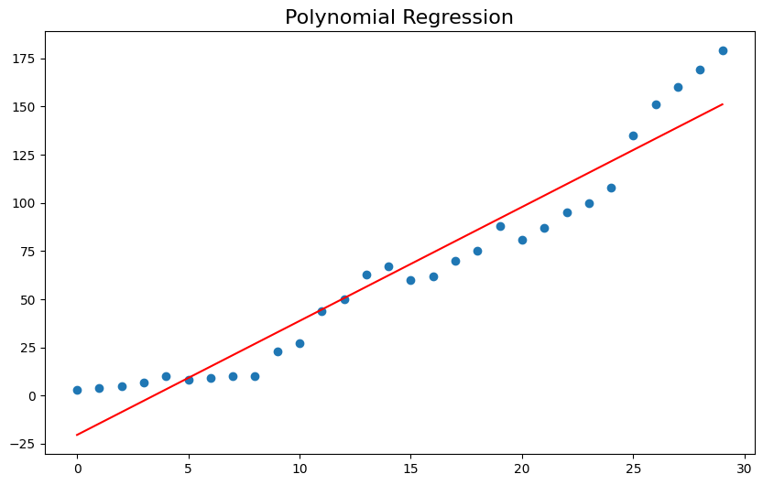

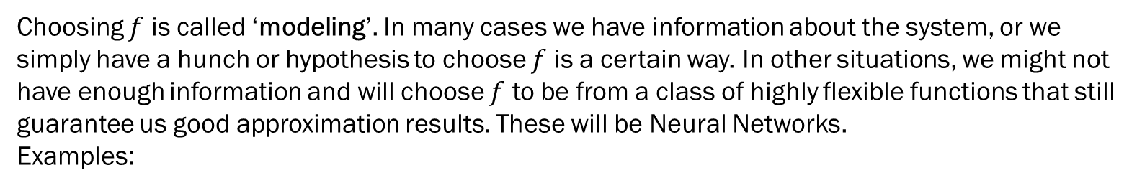
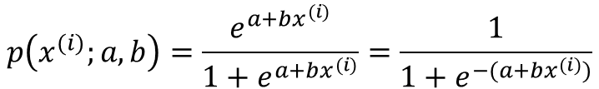

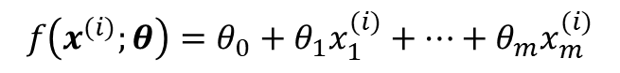
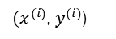
Regression
Choosing $f$ is called ‘modeling’. In many cases we have information about the system, or we simply have a hunch or hypothesis to choose $f$ is a certain way. In other situations, we might not have enough information and will choose $f$ to be from a class of highly flexible functions that still guarantee us good approximation results. These will be Neural Networks.
Examples:
Example 1-dim linear regression
$$f\left(x^{(i)};θ\right)=θ_{0}+θ_{1}x_{1}^{(i)}+…+θ_{m}x_{m}^{(i)}$$
Target y
$$f\left(x^{(i)};θ\right)=θ_{0}+θ_{1}x^{(i)}$$
Linear Regression
$$p\left(x^{(i)};a,b\right)=\frac{e^{a+bx^{(i)}}}{{1+e}^{a+bx^{(i)}}}=\frac{1}{{1+e}^{−(a+bx^{(i)})}}$$
$$ε^{(i)}$$
Logistic Regression
${(x}^{(i)}$, $y^{(i)}$)
Perceptron (1-node NN)
Input Data x
$$f\left(x^{(i)};w\right)=x^{(i)}∙w+w_{0}$$

Slide 9
Regression
Different models are used for different situations:
 | Linear Regression | Logistic Regression | Neural Networks
Features | Continuous numeric / categorical | Continuous numeric / categorical | Continuous numeric / categorical
Targets | Continuous numeric | Categorical (Probability) | Continuous numeric
Relationship between Features and Targets | Linear | linear (with some transformations) | Any continuous function

Slide 10

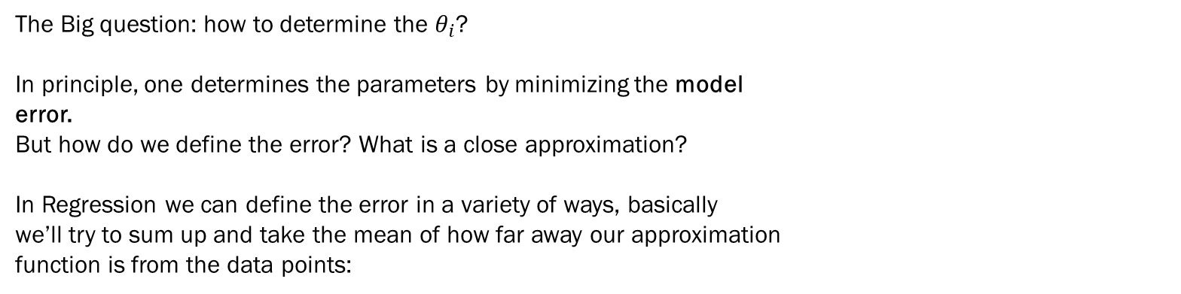

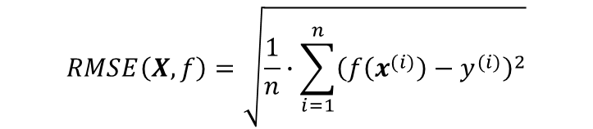
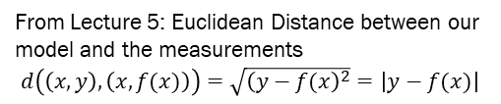
Loss function
Example 1-dim linear regression
The Big question: how to determine the $θ_{i}$?
In principle, one determines the parameters by minimizing the model
error.
But how do we define the error? What is a close approximation?
In Regression we can define the error in a variety of ways, basically
we’ll try to sum up and take the mean of how far away our approximation
function is from the data points:
Target y
$$f(x)$$
Input Data x
From Lecture 5: Euclidean Distance between our model and the measurements
$d\left(\left(x,y\right),\left(x,f(x)\right)\right)=\sqrt{{\left(y−f(x\right)}^{2}}=\left|y−f(x)\right|$
$$RMSE\left(X,f\right)=\sqrt{\frac{1}{n}∙\sum_{i=1}^{n}{{\left(f\left(x^{(i)}\right)−y^{(i)}\right)}^{2}}}$$
$$MAE\left(X,f\right)=\frac{1}{n}\sum_{i=1}^{n}{\left|f\left(x^{(i)}\right)−y^{(i)}\right|}$$
RMSE (Root Mean Square Error, or cost function)
MAE (Mean Absolute Error)

Slide 11
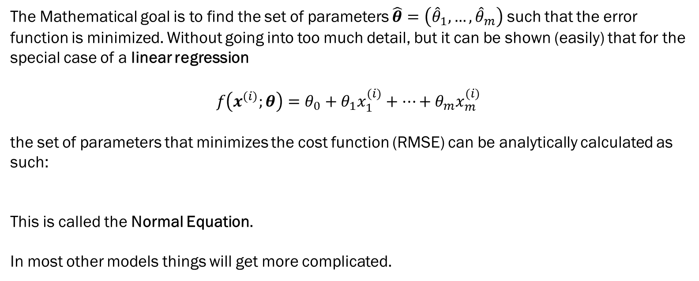
Loss function
The Mathematical goal is to find the set of parameters $\hat{θ}=\left({\hat{θ}}_{1},…, {\hat{θ}}_{m}\right)$ such that the error function is minimized. Without going into too much detail, but it can be shown (easily) that for the special case of a linear regression
$$f\left(x^{(i)};θ\right)=θ_{0}+θ_{1}x_{1}^{(i)}+…+θ_{m}x_{m}^{(i)}$$
the set of parameters that minimizes the cost function (RMSE) can be analytically calculated as such:
This is called the Normal Equation.
In most other models things will get more complicated.
$${\hat{θ}=\left(X^{T}X\right)}^{−1}X^{T}Y$$

Slide 12
Example
Simple Linear Regression

Slide 13
What is the relationship between the price and weight of diamonds?
Plot prices and weights of known cases.
Notes:
Avg price if 0.4
Avg price if 0.5

Slide 14
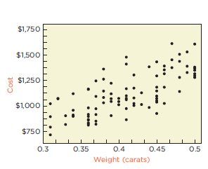
Price and weight of diamonds
Notes:
linear association? r = 0.71

Slide 15
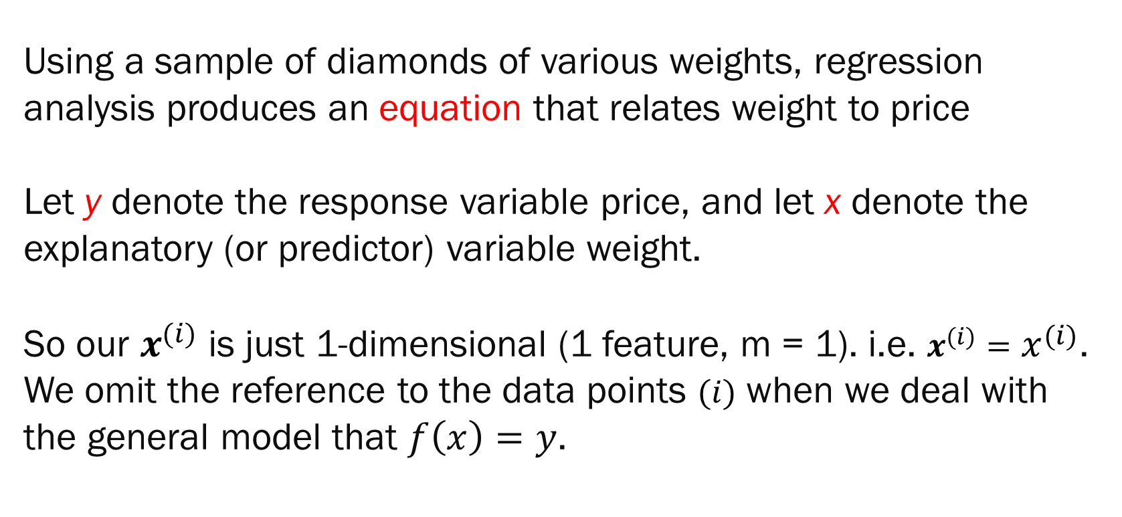
Regression Analysis
Using a sample of diamonds of various weights, regression analysis produces an equation that relates weight to price
Let y denote the response variable price, and let x denote the explanatory (or predictor) variable weight.
So our $x^{(i)}$ is just 1-dimensional (1 feature, m = 1). i.e. $x^{(i)}=x^{(i)}$. We omit the reference to the data points $(i)$ when we deal with the general model that $f\left(x\right)=y$.
Notes:
y = price
x = weight

Slide 16
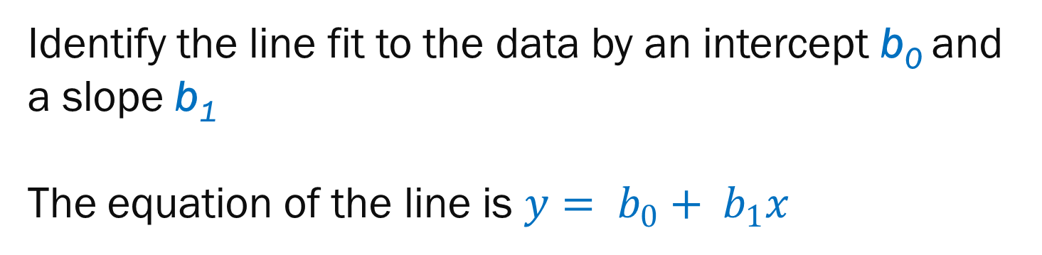
Equation of a Line
Identify the line fit to the data by an intercept b₀ and a slope b₁
The equation of the line is $y= b_{0}+ b_{1}x$

Slide 17
Least Squares
Residual: Vertical deviation of a point from the line
The best fitting line collectively makes the squares of the residuals as small as possible
The choices of b₀ and b₁ minimize the sum of the squared residuals

Slide 18
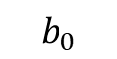
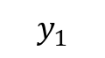
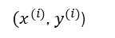
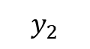
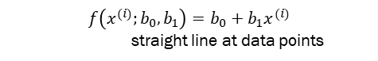
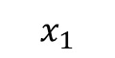

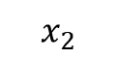
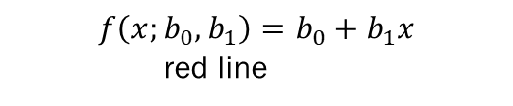
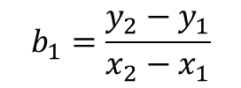
$$f\left(x^{(i)};b_{0},b_{1}\right)=b_{0}+b_{1}x^{(i)}$$
straight line at data points
$$f\left(x;b_{0},b_{1}\right)=b_{0}+b_{1}x$$
red line
Cost ($)
$$ε^{(i)}$$
$$b_{1}=\frac{y_{2}−y_{1}}{x_{2}−x_{1}}$$
${(x}^{(i)}$, $y^{(i)}$)
$$y_{2}$$
$$y_{1}$$
$$Remember:\left(i\right) denotes a point from our data set$$
$$b_{0}$$
Weight (Carats)
$$x_{1}$$
$$x_{2}$$

Slide 19
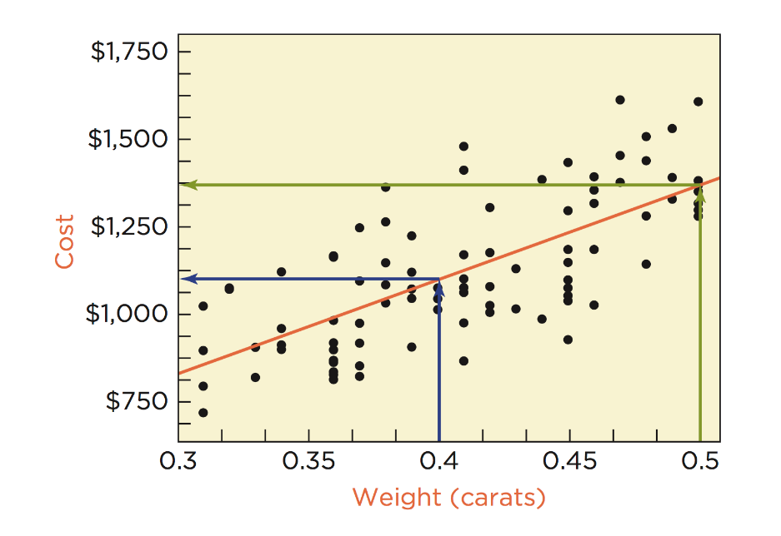
Notes:
linear association? r = 0.71

Slide 20
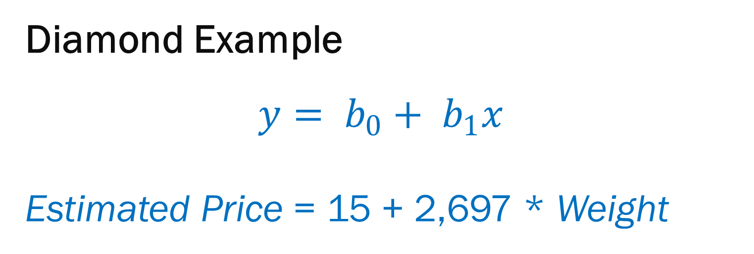
Diamond Example
$$y= b_{0}+ b_{1}x$$
Estimated Price = 15 + 2,697 * Weight
Notes:
0.4 - 1093
0.5 – 270 more
b0 usually extrapolation

Slide 21
Interpretation
Intercept b₀ Average response when x = 0 and where the line crosses the y axis
Slope b₁ Estimates the marginal cost (additional cost for each additional weight) used to find the total cost

Slide 22
Example of regression in python

Slide 23
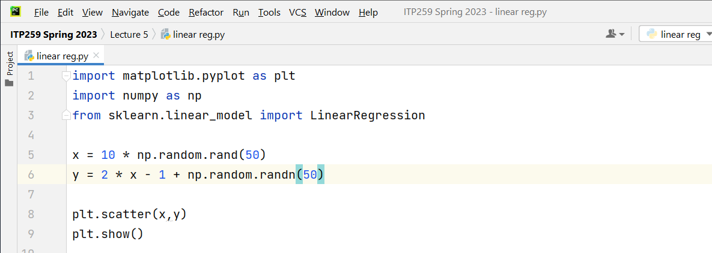
Let's generate random values of x. Then, formulate a y that is a linear dependent of x.
Then we will add some 'noise' to y.
We will then do a linear regression to “discover” that linear formula.
Generate random independent variable x.
Generate a dependent variable y. A contrived
dependency on x (with added randomness)
Regression will try to discover the formula we put in

Slide 24
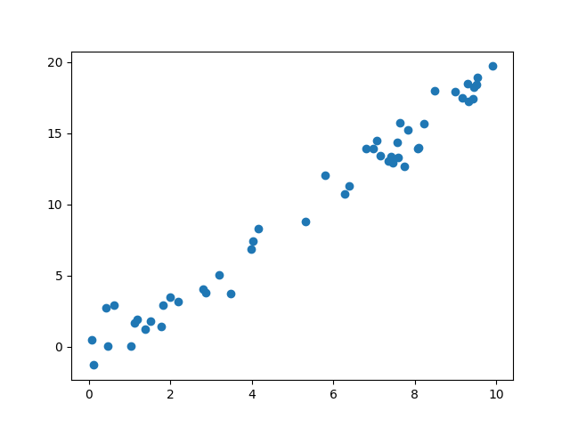

Slide 25
Choose a class of model
(from sklearn)

Slide 26


Slide 27
from sklearn.linear_model import LinearRegression

Slide 28
2. Choose model

Slide 29
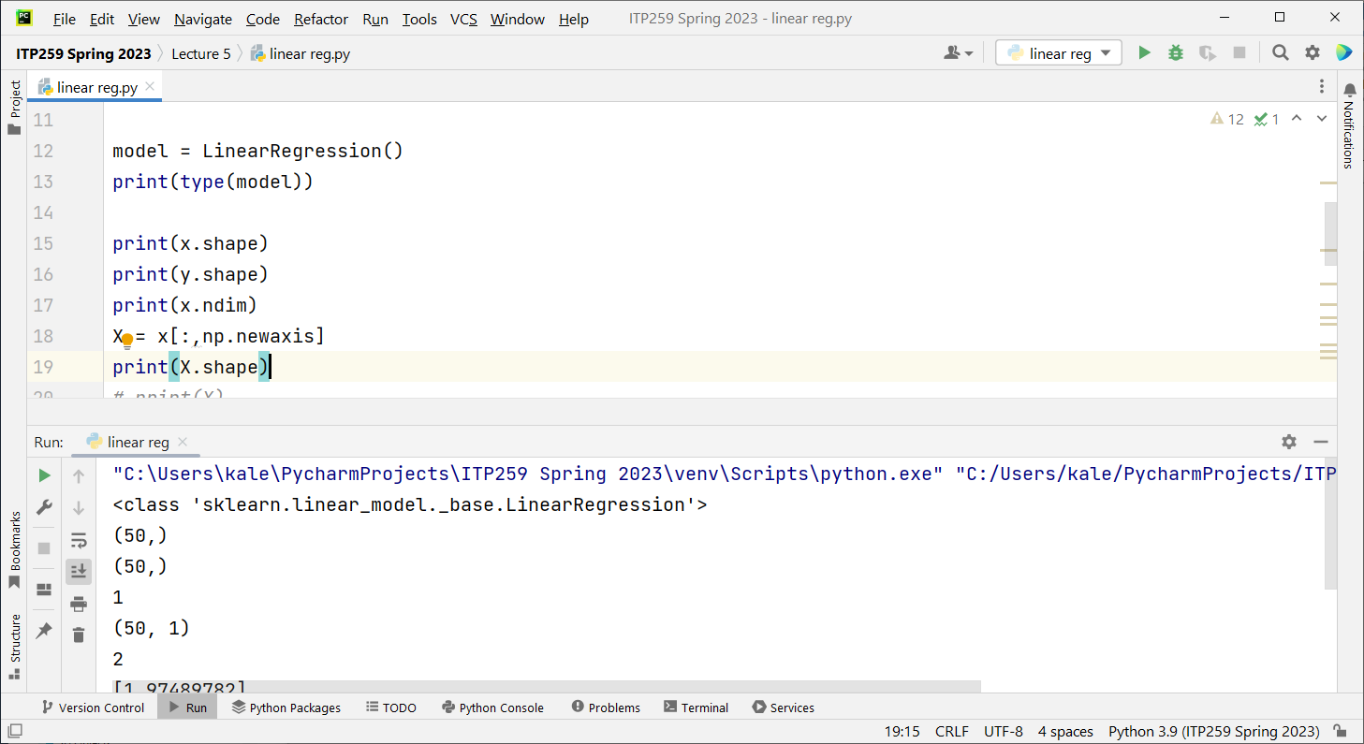

Slide 30
3. Arrange data
Notes:
Into feature matrix and target array

Slide 31
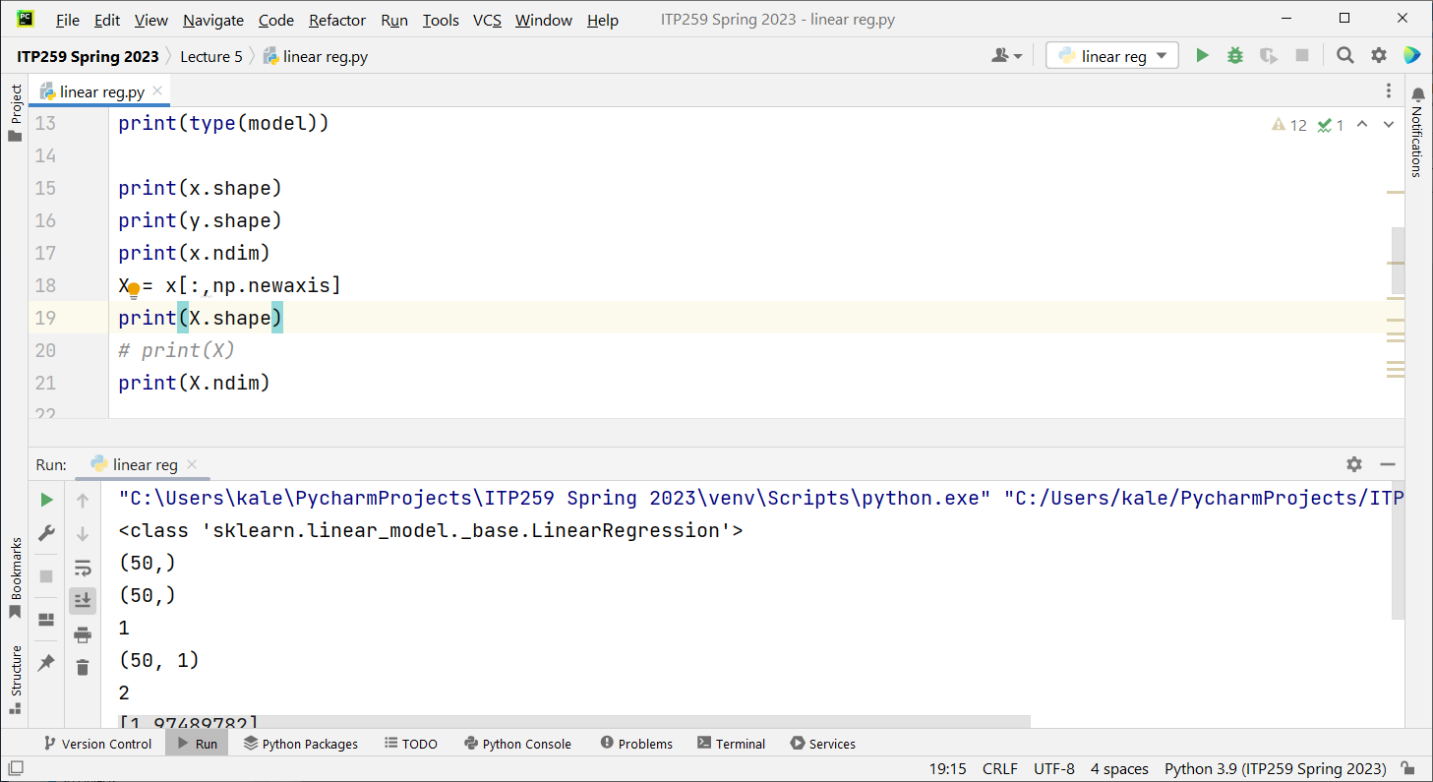

Slide 32
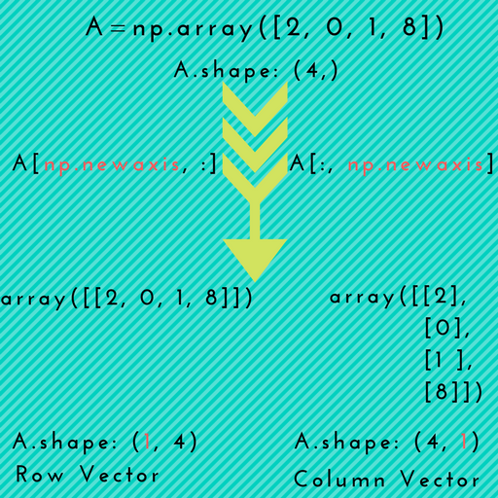
Reshaping our Data
Numpy newaxis is used to increase the dimension of a numpy array.
The reason to do this is LinearRegression requires X to be an array of shape (n_samples, n_features), e.g. (50,1)
print(X.ndim) to know the dimension of the array X
Our X is 2 dimensional

Slide 33
4. Fit the model to the data
5. Predict labels for unknown data

Slide 34
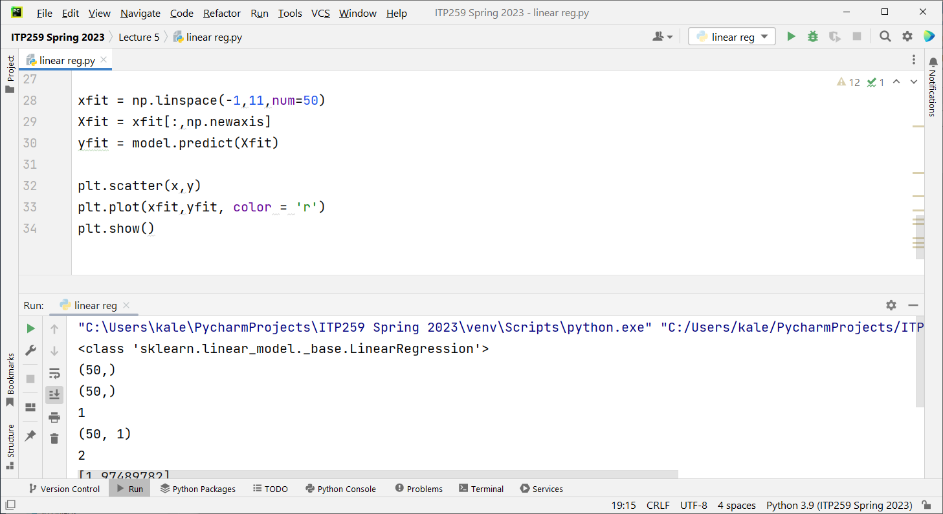

Slide 35
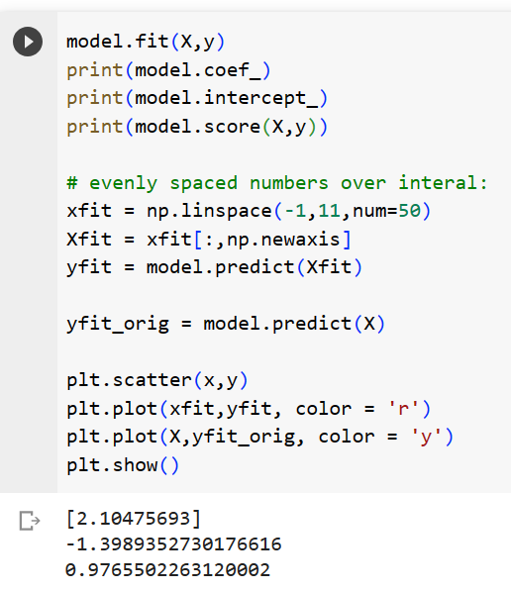
Results
What regression equation did the
model uncover? (would vary because of
the random X and y)
y = 2.02 x – 1.12
Evenly spaced new values for x
Model fit for new values
Predict y-values for the fitted model
Model prediction at original data points
Notes:
computations are stored in model-specific attributes

Slide 36
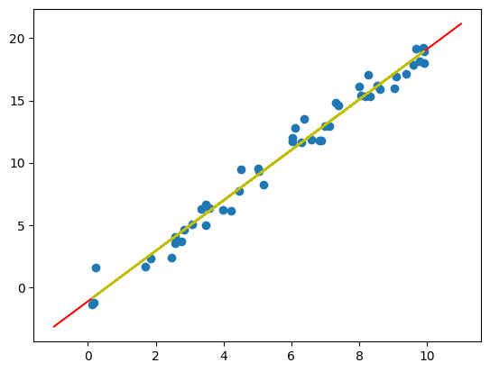
What do the blue dots represent?
What does the red line represent?
What does the yellow line represent?

Slide 37
Classification

Slide 38
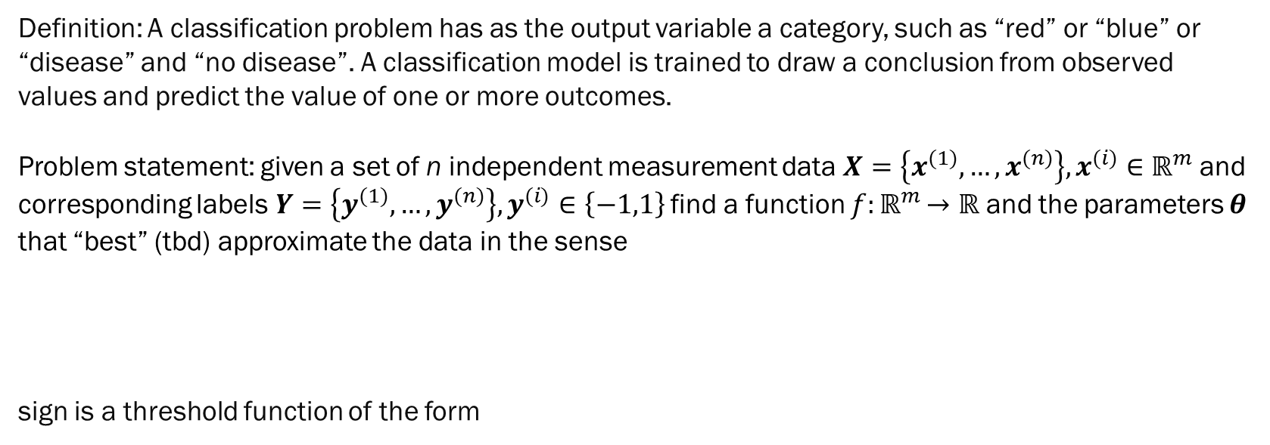
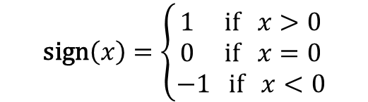

General Formulation
Definition: A classification problem has as the output variable a category, such as “red” or “blue” or “disease” and “no disease”. A classification model is trained to draw a conclusion from observed values and predict the value of one or more outcomes.
Problem statement: given a set of n independent measurement data $X=\left\{x^{(1)},…,x^{(n)}\right\},x^{(i)}∈$ $ℝ^{m}$ and corresponding labels$Y=\left\{y^{(1)},…,y^{(n)}\right\},y^{(i)}∈\left\{−1,1\right\}$ find a function $f{:ℝ}^{m}→ℝ$ and the parameters $θ$ that “best” (tbd) approximate the data in the sense
sign is a threshold function of the form
$$y^{(i)}=\text{sign}\left(f\left(x^{\left(i\right)};θ\right)\right)$$
$$\text{sign}\left(x\right)=\left\{\begin{aligned}1 \text{if} x>0 \\ 0 \text{if} x=0 \\ −1 \text{if} x<0\end{aligned}\right.$$

Slide 39
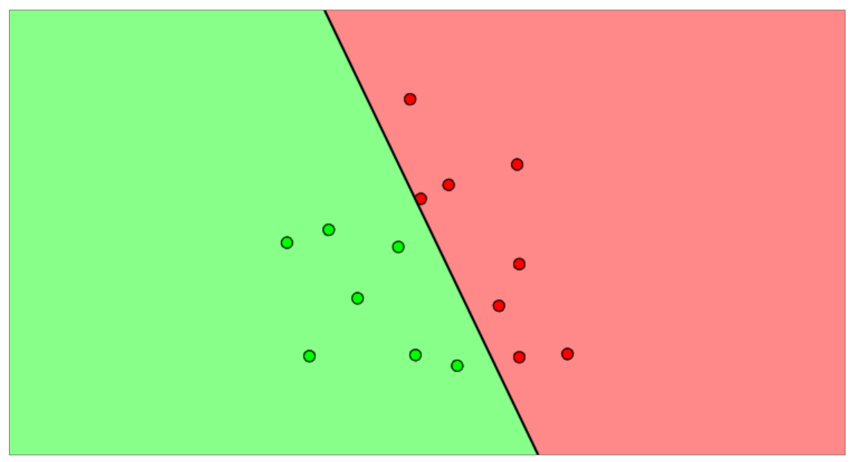

Decision Boundary
As in Regression problems we will solve the problem of finding the approximator function by minimizing a Loss Function that calculates the ‘distance’ between our data points and the output of the model.
We impose a ‘separability condition’ on the problem, that ensures that we can separate the space into a negative and positive class. This will lead to us being able to calculate a decision boundary:
$$y^{(i)}f\left(x^{\left(i\right)};θ\right)≥0$$
$$f\left(x^{\left(i\right)};θ\right)<0$$
$$f\left(x^{\left(i\right)};θ\right)≥0$$

Slide 40
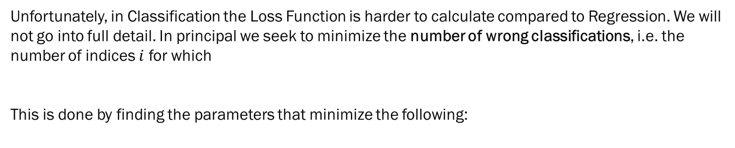



Loss Function in Classification
Unfortunately, in Classification the Loss Function is harder to calculate compared to Regression. We will not go into full detail. In principal we seek to minimize the number of wrong classifications, i.e. the number of indices $i$ for which
This is done by finding the parameters that minimize the following:
$$y^{(i)}f\left(x^{\left(i\right)};θ\right)<0$$
$$\min_{θ}{\sum_{i=1}^{n}{A\left(y^{\left(i\right)}f\left(x^{\left(i\right)};θ\right)\right)}}$$
This is generally quite difficult to solve
A$\left(x\right)=\left\{\begin{aligned}1 \text{if} x<0 \\ 0 \text{if} x≥0\end{aligned}\right.$

Slide 41
Loss Function in Classification
There are a variety of approaches to finding the Loss Function:
Support Vector Machines (SVMs)
Hinge Loss
Logistics Regression
and more
We will dive deeper into Logistics Regression.

Slide 42
Logistic Regression

Slide 43
Logistic Regression
Used to predict binary categories (as opposed to a numerical values as in linear regression) and solve classification problems.
Will customer buy a product? Yes or No
Will the team win the game? Yes or No
Is an email spam or is it ham?
It can also be easily extended to situation with multiple classes (see following lectures).

Slide 44


Intuition
The question was how do we predict classes? In Logistics Regression we model the problem in a probabilistic way, and predict the probabilities of classes.
In the example below, we are trying to predict voting behavior. If we do a linear regression, the fitted line fails to classify the voter. It is even possible for certain values of X, we get a negative value of y (which candidate is that?)
We need the response to be categorical.

Slide 45

Idea for a Solution – Sigmoid Functions
Solution: Find some way to transform the linear regression line to a curve that can classify the voters.
Using logistic regression, the output will be a probability value from 0 to 1, where anything less than (or equal to) 0.5 (known as the threshold) will be considered as voting for candidate B, and anything greater than 0.5 will be considered as voting for candidate A. So, instead of a straight line, we fit a curve - Sigmoid Function.

Slide 46

Sigmoid Function
An "S" shaped curve.
There are several such curves.
The logistic function has the equation:
$y=\frac{e^{x}}{e^{x}+1}=\frac{1}{1+ e^{−x}}$
Properties:
Continuous
Differentiable
Positive derivative everywhere
Bounded between min and max (0-1 for logistic function)
Very useful in machine learning where any range of input values need to be converted to a probability (between 0 and 1)

Slide 47



Linear to Logistic Regression
Lets recap:
We have a binary output variable Y, and we want to model the conditional probability $P\left(Y=1 | X=x\right)$ as a function of x
We assume that we are conducting a Bernoulli trial, i.e. a series of random experiments that only have two possible outcomes: vote yes/no, success/failure, 0/1, etc.
We assume that all “drawings” (imagine an urn) $\left(x^{\left(i\right)},y^{\left(i\right)}\right)$ are independent of another and all have the same probability $p$
We also assume that $p$ can be parametrized by a set of parameters $θ$ in the form
$$P\left(Y=1 | X=x\right)=p(x;θ)$$
We now pick the logistics function to model our probability and assume that it depends on two parameters a,b in a linear way:
$$p(x;θ)=\frac{e^{a+bx}}{{1+e}^{a+bx}}=\frac{1}{{1+e}^{−(a+bx)}}$$

Slide 48



Linear to Logistic Regression
Sidenote: in case we have more than one feature, we can just use the more general expression for the linear regression: $θ_{0}+θ_{1}x_{1}^{(i)}+…+θ_{m}x_{m}^{(i)}$ instead of $a+bx$.
And next we look at the Odds of success given $x$:
The odds are different from the probability which is defined as the number of success cases divided by the total number of experiments; the odds on the other hand is a measure of risk because it is the ratio of the probability of an event happening versus it not happening
We now apply natural log on both sides of the Odds and use $p(x;θ)=\frac{e^{a+bx}}{{1+e}^{a+bx}}=\frac{1}{{1+e}^{−(a+bx)}}$
We now have a simple linear relationship between the odds and the input $x$
$$Odds=\frac{p(x)}{1−p(x)}$$
$$\ln\left(\text{Odds}\right)=\ln\left(\frac{p(x;θ)}{1−p(x;θ)}\right)=\text{easy} \text{calculation}=a+bx$$

Slide 49


Decision Boundary
The linear relationship is important because it gives us a clear way to calculate the decision boundary:
Where this condition is met we have $p\left(x;θ\right)=1−p(x;θ)=0.5$ which is equal to the points with
The region with
Are the points with label +1.
$$\ln\left(\text{Odds}\right)=\ln\left(\frac{p(x;θ)}{1−p(x;θ)}\right)=a+bx=0$$
$$P\left(Y=1 | X=x\right)=P\left(Y=−1 | X=x\right)$$
$$P\left(Y=1 | X=x\right)>P\left(Y=−1 | X=x\right)$$

Slide 50


Estimation / Likelihood
Now the big question is: how can we determine the optimum parameters a,b that define the optimal logistics function to output the optimal classifications; generally we have $m+1$ parameters
We need a cost (or Loss) function again that tells us how close the approximated values are from the actual values.
Under the assumptions from some slides ago (Bernoulli experiment etc), it can be shown that the joint probability of the observations (meaning the probability to obtain a dataset $\left(x^{\left(i\right)},y^{\left(i\right)}\right),i=1,…,n$) is given by the likelihood function
To find our optimal parameters we need to maximize this function; this method is called Maximum Likelihood Estimation (MLE)
Unfortunately we cannot get into details on how to find the maximum, and it’s generally only possible numerically and using methods from solving (non-) convex optimization problems
$$\prod_{i=1}^{n}{P\left(Y=y^{\left(i\right)}| X=x^{\left(i\right)}\right)}=\prod_{i=1}^{n}{{p(x^{\left(i\right)};θ)}^{y^{\left(i\right)}} {\left(1−p(x^{\left(i\right)};θ)\right)}^{1−y^{\left(i\right)}}}$$

Slide 51


Log-Likelihood
The likelihood of observing the data $\left(x^{\left(i\right)},y^{\left(i\right)}\right),i=1,…,n$) is given by the likelihood function
When we take the log of this we see how to interpret that:
Our goal is to classify, i.e. $y^{\left(i\right)}$ is either 0 or 1 (we can always switch between 0/1 and -1/1). Therefore for each data point we either add term 1 OR term 2. Our goal is to have the highest possible probabilities $p\left(x^{\left(i\right)};θ\right)$ corresponding to $y^{\left(i\right)}$ and $\left(1−p\left(x^{\left(i\right)};θ\right)\right)$ corresponding to $\left(1−y^{\left(i\right)}\right)$. That means maximizing this function will give us the optimal parameters $θ$.
$$\prod_{i=1}^{n}{P\left(Y=y^{\left(i\right)}| X=x^{\left(i\right)}\right)}=\prod_{i=1}^{n}{{p(x^{\left(i\right)};θ)}^{y^{\left(i\right)}}{\left(1−p(x^{\left(i\right)};θ)\right)}^{1−y^{\left(i\right)}}}$$
$$\log\left(\prod_{i=1}^{n}{{p(x^{\left(i\right)};θ)}^{y^{\left(i\right)}} \left(1−{p(x^{\left(i\right)};θ)}^{1−y^{\left(i\right)}}\right)}\right)=\sum_{i=1}^{n}{\left(y^{\left(i\right)}\log{p\left(x^{\left(i\right)};θ\right)}+\left(1−y^{\left(i\right)}\right)\log\left(1−p\left(x^{\left(i\right)};θ\right)\right)\right)}$$
1
2

Slide 52

NLL – Negative Log-Likelihood Loss Function
Now it is only a tiny step to arrive at our final loss function. We can just take the negative of that function and minimize it, so we can define our loss function for classifications as:
To illustrate a bit, the general form of a negative log function looks like this:
Since the sum only sums up correctly classified cases, we can interpret this in the way that we penalize situations where we classify correctly, but with very low probability, because then the Loss Function will be very large
Conversely, we want cases in which the sum is large, i.e. probabilities for correct classifications are high
$$J\left(θ\right)=−\log\left(\prod_{i=1}^{n}{{p\left(x^{\left(i\right)};θ\right)}^{y^{\left(i\right)}}{\left(1−p(x^{\left(i\right)};θ)\right)}^{1−y^{\left(i\right)}}}\right)=−\sum_{i=1}^{n}{\left(y^{\left(i\right)}\log{p\left(x^{\left(i\right)};θ\right)}+\left(1−y^{\left(i\right)}\right)\log\left(1−p\left(x^{\left(i\right)};θ\right)\right)\right)}$$

Slide 53
Diabetes Example
https://www.kaggle.com/uciml/pima-indians-diabetes-database
Context
This dataset is originally from the National Institute of Diabetes and Digestive and Kidney Diseases. The objective of the dataset is to diagnostically predict whether or not a patient has diabetes, based on certain diagnostic measurements included in the dataset. Several constraints were placed on the selection of these instances from a larger database. In particular, all patients here are females at least 21 years old of Pima Indian heritage.

Slide 54
Logistic Regression
We have X, the feature set: Pregnancies, Glucose, BloodPressure, SkinThickness, Insulin, BMI, DiabetesPedigreeFunction, Age
X represents the predictor variables.
We have y, the target variable (called Outcome or Response) which we want to predict. Diabetes status. Positive or Negative.
Our task is to train a logistic regression to predict the outcome for a patient with regards to their diabetes risk.

Slide 55


Slide 56


Slide 57

Splitting Data / Overfitting
We have learned that we train our ML algorithms on training data, and then ‘unleash’ it on real life data to make predictions
The problem: How can we be sure that our algorithm generalizes the data set with good accuracy? Maybe we choose too many parameters (model is too complex, has too many $θ$) and the model becomes really good at ‘mimicking’ the training data set, but will perform poorly in production. That is called Overfitting. Of course you should not undersize your model to be able to extract the statistically meaningful facets of your data.
To prevent overfitting and accurately evaluate your model, it’s best practice to separate your data into training and validation data sets. This way, you can prevent your model from overfitting and accurately evaluate its performance.

Slide 58


Overfitting Example
We create a split of test and training data 2/3 to 1/3
Then we fit the model to the training data
Make the prediction on training data and record the accuracy
Then we make the prediction on the test data set
Our algorithm gets more and more accurate on the training data, but starts leveling off on the test data set. That’s overfitting!
https://scikit-learn.org/stable/modules/generated/sklearn.model_selection.train_test_split.html

Slide 59

Overfitting Example
This is how it’s supposed to look like

Slide 60

Notes:
Params – features, target, test size. Optional

Slide 61

1

Slide 62


Slide 63


Another way to track performance for classification: Confusion Matrix
Confusion Matrix | Predicted Response
Actual Response | Yes | No
Yes | True Positives (hit) | False Negatives (miss)
No | False Positives (false alarm) | True Negatives (correct rejection)
We can define the Accuracy of the model in this way:
$$ACC=\frac{\text{Good} \text{cases}}{\text{All} \text{cases}}=\frac{TP+TN}{TP+TN+FN+FP}$$

Slide 64
Categorical Features
Logistic regression requires the features to be numerical.
If features are categorical, convert them to numerical using dummy variables.

Slide 65
Age | Status | Height | Income
23 | Student | 61 | Medium
13 | Student | 55 | Medium
36 | Unemployed | 66 | Low
31 | Student | 64 | Low
58 | Retired | 70 | Medium
29 | Unemployed | 63 | High
39 | Employed | 67 | Medium
50 | Employed | 70 | Medium
23 | Unemployed | 61 | Low
36 | Employed | 66 | High
Target attribute
"Dummy" to the rescue!
Here, status is a predictor attribute, but is categorical.
For logistic regression, we need numerical predictors
If using a data analytics technique that requires numeric predictor attributes, how to deal with “Status?”

Slide 66
Dummy attributes -- Example
Notice how the different values of the categorical variable “Status” have now become attributes with 0-1 values.
Age | Status | Height | Income
23 | Student | 61 | 5000
13 | Student | 55 | 1000
36 | Unemployed | 66 | 3000
31 | Student | 64 | 4000
58 | Retired | 70 | 30000
29 | Unemployed | 63 | 10000
39 | Employed | 67 | 50000
50 | Employed | 70 | 55000
23 | Unemployed | 61 | 2000
36 | Employed | 66 | 20000
But, why only 3?
Age | Student | Unemployed | Employed | Height | Income
23 | 1 | 0 | 0 | 61 | 5000
13 | 1 | 0 | 0 | 55 | 1000
36 | 0 | 1 | 0 | 66 | 3000
31 | 1 | 0 | 0 | 64 | 4000
58 | 0 | 0 | 0 | 70 | 30000
29 | 0 | 0 | 0 | 63 | 10000
39 | 0 | 0 | 1 | 67 | 50000
50 | 0 | 0 | 1 | 70 | 55000
23 | 0 | 1 | 0 | 61 | 2000
36 | 0 | 0 | 1 | 66 | 20000
What is the “status” for this row?
Purely nominal variables can be converted into numeric values by introducing 0-1 dummy attributes.
Dummy attributes are simply the possible values of the nominal attribute. We choose n-1 of the values because we can infer the value of the other, based on these.

Slide 67


Dummy variables
newDataFrame = pd.get_dummies(dataframe, columns=[“col1”,”col2”], drop_first = True)

Slide 68

Multicollinearity
If the categorical variable has k different values (4 in the previous example), then we need only $k−1$ (3) dummy variables.
The 4th dummy variable is dependent on the others and can be inferred.
Including all k variables in the regression will cause multicollinearity.
Multicollinearity occurs when an independent variable (predictor) is a linear combination of other independent variables. All our assumptions have been based on the fact that the features are statistically independent variables and only the target is dependent.
This can lead to instability in computation.
Because of this, it can be difficult to test the individual significance of variables on the dependent variable.

Slide 69


Logistic Regression Summary
Logistic Regression is an equivalent approach to a Linear Regression, just that we don’t want to model a continuous variable, but a binary categorical problem.
Low income = very low probability of voting for Candidate B
High income = very high probability of voting for Candidate A
Medium income = close to 0.5 probability of voting for Candidate A/B
Fit straight line through the data
2 parameter model in the form $a+bx$
Measure error using R2 (R-square)-method, RMSE; error measure is basically the distance of data points to the model
Fit S-curve through the data
2 parameter model in the form of the logistic function $\frac{1}{{1+e}^{−(a+bx)}}$; interpreted as the probability of a classification
Measure error using Maximum Likelihood function, leads to error measure called ‘cross-entropy’ by counting the number of misclassifications

Slide 70
Classification
Demo: Iris Flower Dataset

Slide 71


Slide 72

Problem: Irises have many species. We have identified three species for this problem. And we have determined the species of each flower. We have also measured the petal and sepal length and width.
Can we predict classify Irises into one of three species knowing the dimensions (features)?
Terminology: The dimensions are features. The species is the response, or target, or dependent, or the class.

Slide 73

Table of data: Feature matrix X 2D with shape [n_samples, n_features] contained in array or DataFrame
Column: Feature
Number of rows: n_samples
Row: Sample
No of columns: n_features

Slide 74
Dependent variable: Target array y 1D with length n samples contained in array or Series

Slide 75


m

Slide 76

Seaborn

Slide 77
kNN for Classification: k Nearest Neighbors
You are likely to be similar to your “neighbors”.
If I know your neighbors’ features and response, I can predict your response, given your attributes.
The neighbors 'vote'. Majority class wins.

Slide 78
Intuition / Motivation
Age | Gender | Income | … | … | Outcome
35 | M | $ 40,000 | … | … | Buyer
40 | F | $ 50,000 | … | … | Buyer
30 | M | $ 25,000 | … | … | Non-buyer
35 | M | $ 40,000 | … | … | Buyer
40 | F | $ 50,000 | … | … | Non-buyer
30 | M | $ 25,000 | … | … | Non-buyer
35 | M | $ 40,000 | … | … | Buyer
40 | F | $ 50,000 | … | … | Non-buyer
30 | M | $ 25,000 | … | … | Non-buyer
… | … | … | … | … | …
… | … | … | … | … | …
… | … | … | … | … | …
… | … | … | … | … | …
… | … | … | … | … | …

Slide 79
Intuition / Motivation
… | … | Outcome
… | … | Buyer
… | … | Buyer
… | … | Non-buyer
… | … | Buyer
… | … | Non-buyer
… | … | Non-buyer
… | … | Buyer
… | … | Non-buyer
… | … | Non-buyer
… | … | …
… | … | …
… | … | …
… | … | …
… | … | …
New case:
Age: 40
Gender: F
Income: $55,000
...
Buyer or Non-buyer?

Slide 80
Intuition / Motivation
Classify based on k most "similar" cases in the historical data
… | … | Outcome
… | … | Buyer
… | … | Buyer
… | … | Non-buyer
… | … | Buyer
… | … | Non-buyer
… | … | Non-buyer
… | … | Buyer
… | … | Non-buyer
… | … | Non-buyer
… | … | …
… | … | …
… | … | …
… | … | …
… | … | …
New case:
Age: 40
Gender: F
Income: $55,000
...
If Majority is Non-buyer
then classify as Non-buyer

Slide 81
Predominantly “Red” neighbors -- classify as “Red”
A
B
Predominantly “Blue” neighbors – classify as “Blue”

Slide 82
One approach: kNN for Classification: k Nearest Neighbors
kNN is a supervised, but NON-parametric classification & regression algorithm
It is NOT a clustering algorithm like Kmeans (which was un-supervised)
kNN is called a lazy learning algorithm, because it does not actually process the training data until a prediction is made; the training data is just stored at first
To make a prediction for a new data point, kNN finds the k nearest neighbors of that data point and computes the class label (classification) or continuous target (regression) based on the k nearest (most “similar”) points

Slide 83
kNN Algorithm
The previous figure shows the political affiliations of a set of people in a certain neighborhood. Suppose also that the locations of the dots also represent the actual locations of the households.
Now, we are asked to guess for the two households that are neither red nor blue and marked as “A” and “B”, what our best guess would be for how they would vote. What would your guess be for the “A”? How about for “B”?
It would be safe to say that the top half represents a red neighborhood and the bottom half a blue one, and we would therefore guess accordingly for each of the two unknown cases “A” and “B”.
The K-Nearest Neighbor approach simply formalizes this intuition. Given a set of cases whose classifications are known and given a new case to be classified, we simply look at the “neighbors” of the new case within the known cases and then classify the new case depending on the majority class of the neighbors.
In the above example the neighbors of “A” are predominantly red and those of B, predominantly blue.

Slide 84



kNN Algorithm Formalized
Goal: predict class label / target for a new data point (called query)
Load the data $\left(x^{\left(i\right)},y^{\left(i\right)}\right),i=1,…,n$
Initialize k to your chosen number of neighbors (tbd how to choose k)
For each $i=1,…,n$
3.1 Calculate the distance between the query point and all other current${ x}^{\left(i\right)}$; possible metrics: Euclidean distance, Manhattan
3.2 Add the distance and the index of${ x}^{\left(i\right)}$ to a re-ordered collection
Sort the ordered collection of distances and indices from smallest to largest (in ascending order) by the distances
Pick the first k entries from the sorted collection
Get the labels of the selected K entries
If regression, return the mean of the k labels
If classification, return the mode of the k labels
$$y$$
?
$$x$$

Slide 85




kNN Algorithm Summarized
Step 0: Plot the data
Step 1: Calculate Distances
Step 3: Find Neighbors
Step 4: Vote on Labels
Distance
Class
Votes
1.8
1st NN
3
$$y$$
$$y$$
1.9
2nd NN
1
2.8
3rd NN
3.0
4th NN
$$x$$
$$x$$
Task: classify the red point into a class. There are 3 potential classes
Start by calculating the distances between the red point and all others
Next find the nearest neighbors by ranking points by increasing distance. The nearest neighbors (NNs) of the red point are the ones closest in the data space
Vote on the predicted class labels based on the classes of the k nearest neighbors (here k=3)

Slide 86
How many neighbors to consider?
Small Latching onto noise
Too little specificity

Slide 87
How to determine the number of neighbors: k?
Two important questions arise:
How many neighbors to consider?
In the present example, the idea of “neighbor” seems clear. How about in a general case – what would “neighbor” mean for some of the data sets we have looked at earlier? How would we calculate distance?
Let us look at the easy question (the first one) first:
If we consider too few neighbors, then we might end up classifying a case based on accidental occurrences that do not reflect the real situation. In the example, if we consider only one neighbor, we can see that in either case, the closest point is of the opposite color of the general pattern of the region. So too small a value for the number of neighbors could end up with noise determining our classification.
On the other hand, too high a value would cause a loss of sharpness. In the above case, suppose we considered a value like 50 then we would classify every new case based simply on the overall majority, without considering “local” characteristics at all and this would be the equivalent of using the Naïve Rule.
We need to strike a balance.
We will build models with different values for k and choose the one that performs best on the validation partition.

Slide 88
Definition of distance and neighbors
Income: $85,000
# Cars: 2
Neighbors?

Slide 89
Definition of distance and neighbors
Suppose our data is not inherently geographical, how would the concept of neighbor apply?
For example, suppose we have data like that shown on the left and have a person whose income is $85,000 and who owns 2 cars. How do we find the neighbors of this person?
We can use the notion of “distance” that we talked about in the first two lectures.
That is, we could consider each case as a set of x-y co-ordinates and then calculate the so-called Euclidian distance that results from applying Pythagoras’ theorem.

Slide 90
Numeric attributes
(85000, 2)
How far away is ?
$$d\left(\left(95000,1\right),\left(85000,2\right)\right)=\sqrt{{\left(95000−85000\right)}^{2}+{\left(1−2\right)}^{2}}$$
Euclidian distance

Slide 91
Non-Numeric attributes
kNN: Classification & Regression
For this course:
Categorical target
Numerical features
Since kNN relies on the notion of distance, the predictor attributes (features) must be numeric. Categorical features will not work.
kNN can be used for both classification and regression. In this lecture we will look at its use for classification. When used for classification, kNN will treat the target attribute as categorical, even if it is encoded as a number.

Slide 92
Scaling
(95000, 1)
(85000, 2)
10000.00005
(95050, 1)
(85000, 2)
10050.00005
(95000, 3)
(85000, 2)
10000.00005
(95000, 5)
(85000, 2)
10000.0004
Distance is insensitive to number of cars …

Slide 93
Scaling
Because of the relative magnitudes of the two variables, one dominates the distance measure.
What can we do?
We can use a normalizer or a standard scaler. That way no attribute will dominate the distance measure.

Slide 94
Categorical features > Dummys
Distance
Numerical Predictors
What to do about categorical attributes?
Since distance calculations require numerical predictors, what can we do if we have categorical attributes?
We can use the dummy attribute technique we encountered in Logistic Regression.

Slide 95
Numerical Target > Binning
When we have a target attribute that is numeric, but we want it to be categorical so that we can use a classification method, we can resort to binning, which is just a way to say that we will create a discrete number of bins into which we will slot the values.
In the previous slide, we have broken up the whole range of the variable into six bins of interval size 50 units. The resulting values are shown on the right.

Slide 96
Binning for Target
60
14
81
1
164
107
181
17
114
119
171
58
238
267
35
B
A
B
A
D
C
D
A
C
C
D
B
E
E
A
0 | A
50 | B
100 | C
150 | D
200 | E
250 | F
Original
Bins
Binned

Slide 97
Summary
kNN expects features to be numerical
kNN expects targets to be categorical (for classification)
Non-Numerical feature
Non-Categorical target
If any predictor attribute (feature) is categorical – convert to dummy attributes
If target attributes not categorical:
Consider “binning” or
Use kNN for regression instead

Slide 98
Training Data
Unlike almost any other predictive analytics technique kNN requires three partitions. It uses two partitions to train and test the model, and one partition (called Cross-Validation) to find optimal k.
In Cross-Validation we resample the data in every iteration of the model (different values of k) and track the model accuracy.
We call the first two partitions as Training and Test partitions. The third is called CV (Cross-Validation).

Slide 99
Step 1: Scaling
Riding Mowers Data Set
Income Lot_Size Response
0 34 26 Not Bought
1 34 40 Not Bought
2 34 46 Not Bought
3 34 48 Not Bought
4 34 53 Not Bought
.. ... ... ...
175 86 121 Bought
176 87 109 Bought
177 88 119 Bought
178 89 110 Bought
179 89 124 Bought
Income Lot_Size
0 0.794358 0.607450
1 0.647648 0.761939
2 0.594391 0.804176
3 0.578017 0.816024
4 0.539955 0.841694
.. ... ...
175 0.579325 0.815097
176 0.623820 0.781568
177 0.594581 0.804036
178 0.628995 0.777409
179 0.583096 0.812403
Standard Normalization

Slide 100
Step 2: Partitioning
Income Lot_Size
15 0.807791 0.589469
132 0.520865 0.853639
6 0.499299 0.866430
177 0.594581 0.804036
36 0.732793 0.680451
.. ... ...
115 0.568327 0.822802
[126 rows x 2 columns]
Training (70%)
Income Lot_Size
0 0.794358 0.607450
1 0.647648 0.761939
2 0.594391 0.804176
3 0.578017 0.816024
4 0.539955 0.841694
.. ... ...
175 0.579325 0.815097
176 0.623820 0.781568
177 0.594581 0.804036
178 0.628995 0.777409
179 0.583096 0.812403
Income Lot_Size
120 0.514496 0.857493
27 0.433473 0.901167
95 0.682745 0.730657
121 0.495366 0.868685
2 0.594391 0.804176
0.574946 0.818192
[54 rows x 2 columns]
Test (30%)
Cross Validation (random split of the data)
162 0.619155 0.785269
169 0.617497 0.786573
63 0.852851 0.522154
45 0.578747 0.815507
100 0.666465 0.745537
73 0.866186 0.499722
38 0.606914 0.794768
93 0.852171 0.523263
155 0.590391 0.807117
160 0.626557 0.779376
118 0.653127 0.757249
5 random groups

Slide 101
Step 3: run kNN Algorithm
With the Training and Test partitions, we will illustrate the process for k=3. Note that we are using the standardized attributes.
To classify a row (the query) of the training data, we do the following:
Find its closest three neighbors (since our k is 3) in the Training partition using the usual distance formula.
Find which response category has a majority among the three neighbors
Classify the query as belonging to the majority case.
Classify all cases in the Training partition set using the same method. We then apply the model to make predictions on the Test partition.
At the end of the process, we will have the model’s classifications for k=3. For each case, we also know the actual classification. Based on this, we can calculate the error matrix for both Training and Test data set. In Python we will calculate the ‘score’ which is the fraction of correctly classified samples (float). We will call that model accuracy.
We repeat the same process for many other values of k and choose the k that performs best. We will do that on all 3 data partitions, and especially use the accuracy results on the Cross-Validation data set.

Slide 102



Step 4: Results
On Test Dataset
k=1
k=8
k=24
0.59
0.63
0.59
Accuracy = correctly classified samples divided by total sample size

Slide 103

Step 4: Different values of k

Slide 104
Is this good?
Not really.

Slide 105

Step 5: Calculate Lift
We can ask ourselves: was building a model worth it?
To answer that we can compare the probability that our model correctly classifies a query (called performance) to us just guessing the right classification.
In our case, the probability of a non-buyer is 59% and of a buyer 41%. Since there are only 2 possibilities, one would always guess non-buyer to achieve maximal predictive performance.
Our kNN algorithm produced an accuracy (for k=8) of 63% correctly classified samples.
Therefore we define the model lift as
which is not very good.
$$\text{Lift}=\frac{\text{Performance} \text{with} \text{model}}{\text{Performance} \text{without} \text{model}}=\frac{0.63}{0.59}=1.07$$

Slide 106

It works better on the Iris dataset (see Colab)

Slide 107
Summary of kNN process
Normalize Data
Use if performance is acceptable
Partition Data
Try several k values on Cross-Validation
Select best k value
Apply on Test partition

Slide 108
Wine quality
kNN Demo

Slide 109
Classify wine quality exercise
Import wine dataset
Plot count of wine quality
Import kNN classifier
Instantiate the classifier
Set the factors and response arrays
Normalize the factors
Partition the dataset
Fit
Predict
Iterate on different value of K
Plot the accuracy scores (training and testing) of the model for various ks
Which K is best?

Slide 110
Wine dataset
Posted on Blackboard

Slide 111



Slide 112

Histogram of the Wine Data column ‘Quality’

Slide 113

Split the data
Stratify = y means partitions will have the same proportions of classes as in vector y

Slide 114


Slide 115


Slide 116


What k would you choose?
Look at odd values of k to avoid tie breaking.
Why is the training accuracy 100% ?
Rule of thumb $k=\sqrt{n/2}$ where n is the number of samples
We would choose k = 23 or 27

Slide 117
Summary
In supervised ML, we have a response (target) variable which we are trying to predict
The confusion matrix displays how well the model does in the prediction
We saw how to use kNN for the classification problem
We will learn how to use Neural Networks for classification next

